Slide 1
Group: Developers Geek
Group - 5
Project Name: Petrol Pump Management System

Slide 2
Group Member
Shakil Ahmed
ID: 17182103010
Arifur Rahman Kawser
ID: 17182103012
Momin Ali
ID: 17182103011

Slide 3
Introduction
Petrol pump management system is a complete accounting & inventory system for petrol pumps. This software covers all the functionality of a petrol pump from meter reading to lubricant sales, credit sales, dip stock v/s actual stock etc. All the information about sale, purchase, stock will be maintain properly in this system. The project is developed using C# Language.

Slide 4
Purpose of the Application
The main objective of this system is to maintain their sales detail, employee detail in files and folders. They use to keep the record of petrol and diesel sold, inventry,Supplier, Customers, etc in a register. A daily register is maintained to keep track of sales. The Project is based on a concept to maintain and generate the petrol pump’s transaction.

Slide 5
Tools Used
Visual Studio IDE
MS Access Database

Slide 6
Features of this Software
Login
Bank Account Details
Customer Account Details
Customer Deposit Pump Account Detail
Supplier Account
Supplier Withdraw Pump Accounts detail
Employee Details
Product Details
9. Lubricant Details
10. Ledger Details
11. Daily Sales
12. Product Order Details
13. Stock Details
14. Daily Product stock
15. Generate Customer Bill

Slide 7
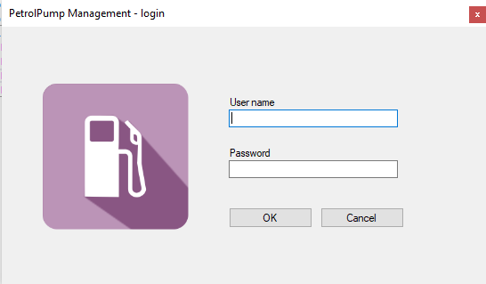
Login module with interface

Slide 8
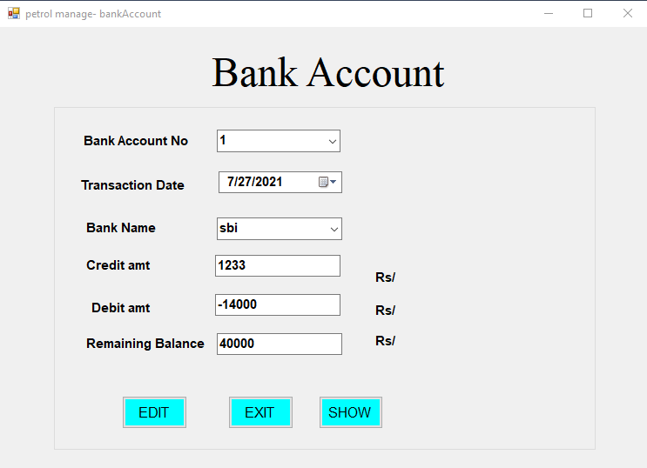
Bank Account Details module with interface

Slide 9
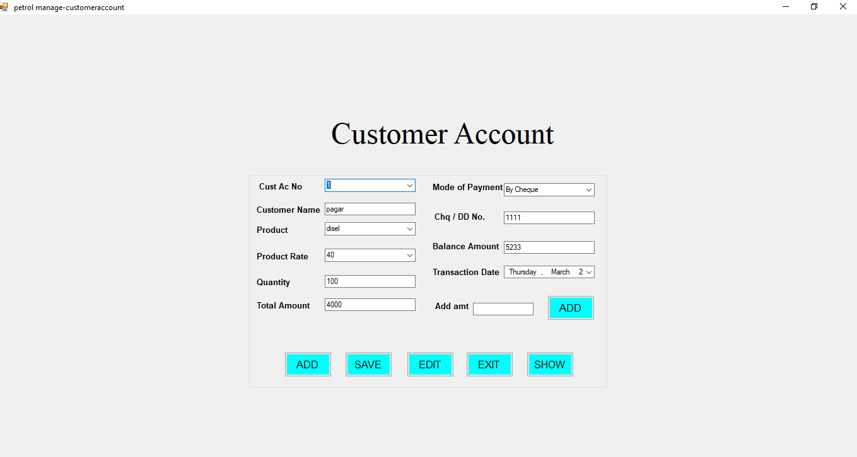
Customer Account Details module with interface

Slide 10
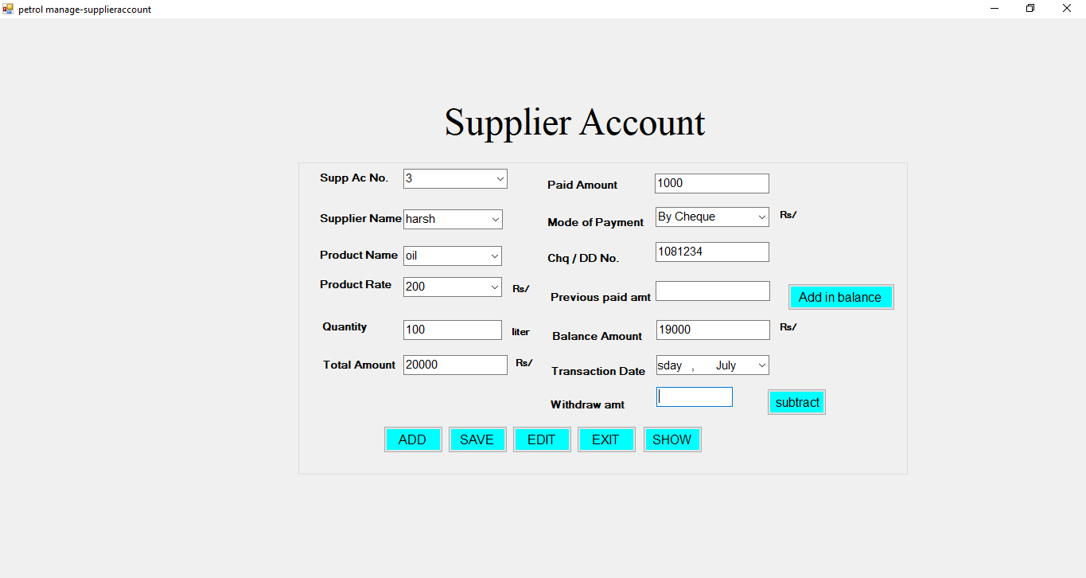
Supplier Account module with interface

Slide 11
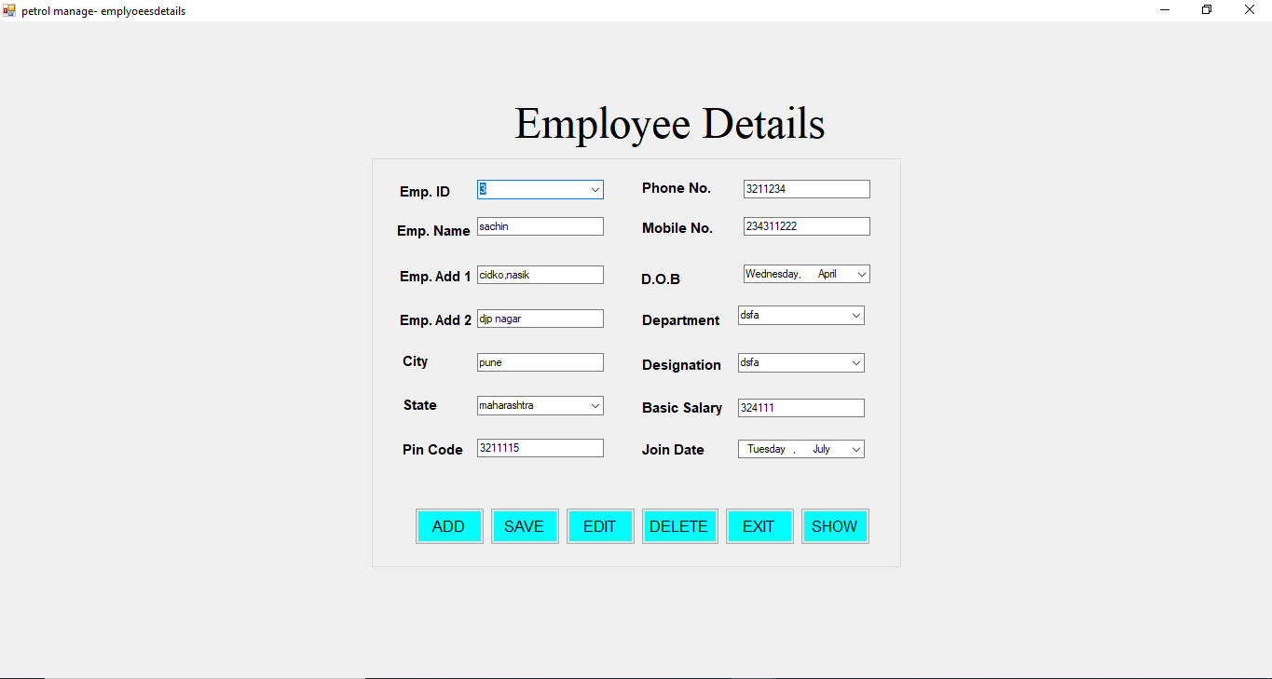
Employee details module with interface

Slide 12
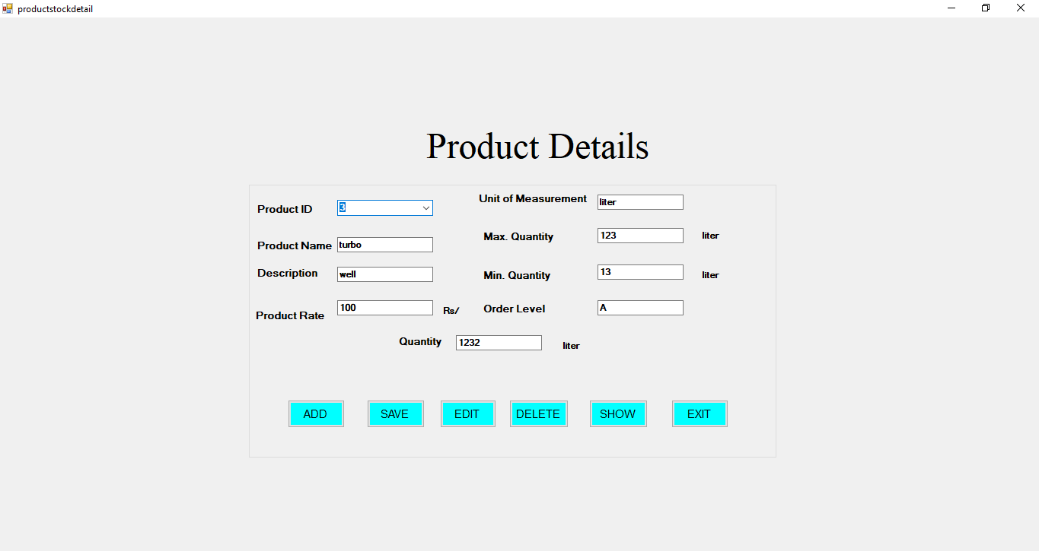
Product Details module with interface

Slide 13
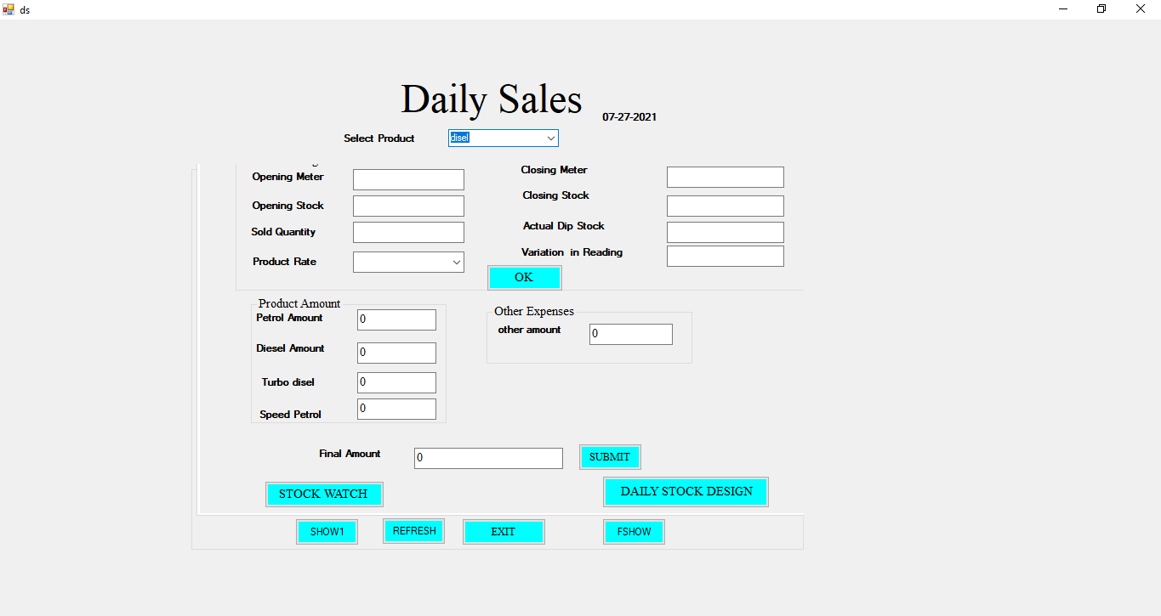
Daily Sales module with interface

Slide 14
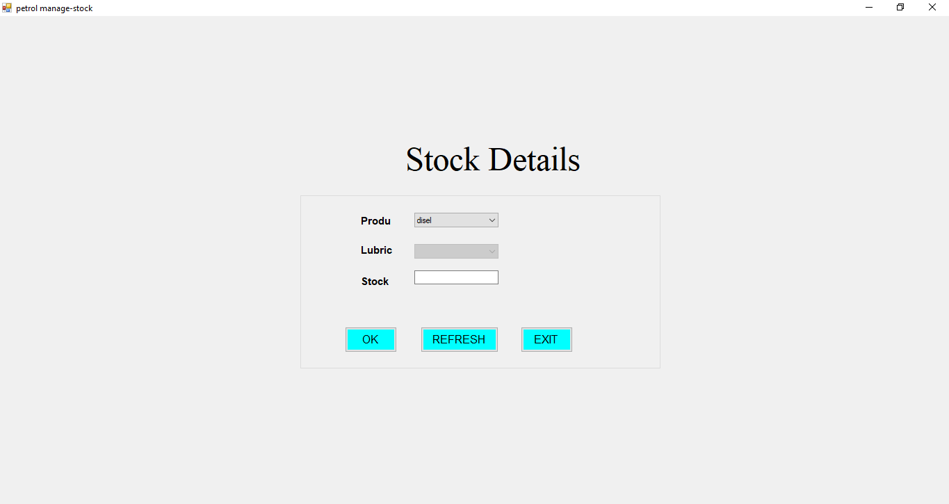
Stock Details module with interface

Slide 15
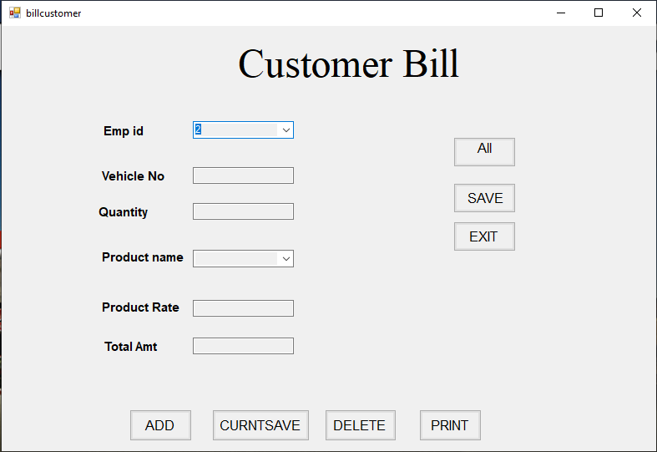
Generate Customer Bill module with interface

Slide 16
Future Implementation
Add chat option for employee to customer, supplier.
Create a website based on this apps.
Realtime location direction of that company’s petrol pump branches.
Updated price list of products.

Slide 17
Conclusion
This project uses an MS Access database. Information stored on the database is retrieved easily with each and every detail. All the daily reports can also be generated from the system. Petrol Pump Management System project helps in the management of a petrol pump transaction and their products within a short period of time. This project is easy to operate and understood by the users. It is very user friendly and easy to handle.

Slide 18
Thank You

